Slide 1

IT as a Service
Leveraging Private, Public and Hybrid Clouds at Lone Star!
The Lone Star College system is leveraging Private, Public and Hybrid clouds to move from “IT” as a commodity to IT as a strategic enabler. Today’s instructors and students expect technology in the classroom to be as flexible as it is on their own personal systems.
LSCS redesigned our enterprise core infrastructure on flexibility, agility and the cloud. This journey into the clouds has enabled us to deliver the IT services efficiently.
VMworld 2011 - CIM 2520
Link Alander,
Associate Vice Chancellor,
Technology Services
Cory Bradfield,
Senior Systems Administrator

Slide 2
Presentation Overview
Overview - The Lone Star College System
We Stumbled into the Cloud
  Strategy - Enabling
  Our Private Cloud
Leveraging Cloud’s in the Public Sector
Tying it all up
  Organizational Impact - Challenges
  What’s Next!
Questions and Answers
“ A pessimist sees only the dark side of the clouds, and mopes; a philosopher sees both sides, and shrugs; an optimist doesn’t see the clouds at all – he is walking on them. “
Leonard Louis Levinson

Slide 3
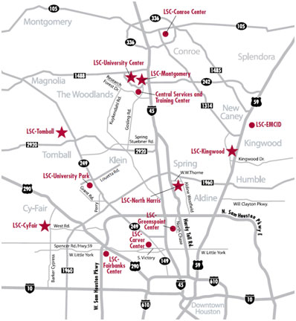
The Lone Star College System
16 Locations across 1,400 square miles
  6 Colleges, 2 University Centers, 8 Instructional Centers
  21 new buildings in 2011
    5 new geographic locations
    Over 2,300,000 new sq. ft. to support
Growth
  63,000 students to over 90,000 in just 3 years
Our Customers
  Over 90,000 Students
  Over 4,800 Employees
  Supported by 163 OTS staff

Slide 4
Our Problems in 2008
Unreliable Services – constant outages
Aged Hardware – 60 percent of datacenter hardware was end-of-life
Our Student System (ERP) could not handle the volume of students registering
Storage was not unified

Slide 5
The Enterprise Transformation
Business Alignment
Technology Foundation
Best Practices
Transformation using Best Practices, Business Alignment and a solid Technology Foundation to become a Strategic Partner and raise our enterprise
IT Maturity.
Strategic Alignment
Strategic Plan for IT aligned with the College Systems Strategic Plan
Organizational Transformation | Infrastructure Transformation | Business Transformation
Reorganized 6 into 1 (May 08) | WAN redesign (Apr 08) | ERP Assessment (Jan 09)
IT Standards (Jun 08) | AD/Exchange redesign (Nov 08) | ERP Selection (May 09)
Restructured Positions (Sep 08) | 5-nines Standard (Jan 09) | ERP Implementation (Sep 09)
IT Governance (Oct 08) | IT Service Continuity (Apr 09) | - Finance Live (Jan 10)
Established KPI’s (Dec 08) | VM First Policy (Dec 08) | - Employee Portal Live (Jan 10)
24/7 Service Desk (Jan 09) | Client Management (Mar 09) | - Student Portal (Jun 10)
ITSM Alignment (Feb 09) | Green Computing (Mar 09) | - Campus Solution (Dec 10)
Executive Reporting (Feb 09) | Advanced Power Mgt. (Dec 09) | - HR (Dec 10)
Managing Change (Oct 09) | New Green Data Center (Sep 10)

Slide 6
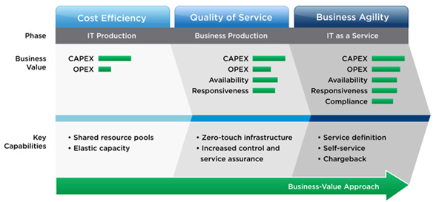
We Stumbled into the Cloud
Lone Star College Systems – Strategic Technology Initiatives 2008-2010
WAN redesign (Apr 08)
AD/Exchange redesign (Nov 08)
VM First Policy (Dec 08)
5-nines Standard (Jan 09)
ERP Implementation (Sep 09)
New Green Data Center (Sep 10)
OUR GOAL: Best Practices, Business Alignment, Strategic Partner , IT Maturity and High Availability (99.999) standard
VMware’s Model
Vmworld 2010
IT as a Service
Business Value Approach

Slide 7
Keys to Enabling the Cloud
Virtualization First
  Critical when creating a Private Cloud
  Must be beyond Tier III and Tier II server virtualization (80 to 95 percent)
Storage
  Must be dynamic and unified
  Must be flexible - Virtualized
Network Design
  Load Balancing
  Application Awareness
Identity/Access Management (Federation)
  SAML OASIS
    Security Assertion Markup Language
  Secure LDAP

Slide 8


Leveraging The Cloud
Everybody has a Cloud today
Public Cloud Consumer
Facebook
Twitter
YouTube
Rackspace
Service Now
Enterprise WebEx
Sales Force
Public
SaaS
Hybrid - IaaS
Blackboard
Hybrid - PaaS
IDC-KW
IDC-NH
Microsoft
Live.edu
IDC-CF
Dynamic
IDC-MC
Dynamic
IDC-TC
Hybrid
Dynamic Services
LSCS Mgt.
MDC-SO
MDC-UP
Lone Star College System
Private Cloud
Microsoft
Live.edu
Student

Slide 9
LSCS – Public Cloud
Public Cloud
  Sets new expectations from our customers
  It’s out of control – Social Media policy
  365,000 Student E-mail accounts
Public Cloud Consumer
Facebook
Twitter
You Tube
Microsoft
Live.edu
Essential Characteristics
On-Demand Self-Service
Broad Network Access
Resource Pooling
Rapid Elasticity
Measured Service
Challenges/Opportunities
Control – no contracts
Availability – no SLA
Expectations
Security – Where is your data
Policy

Slide 10
LSCS – Hybrid Cloud
Software as a Service (SaaS)
  Service Now – IT Service Desk
Infrastructure as a Service (IaaS)
  Rack Space
    Additional external capacity
    VMware infrastructure
    Ability to swing servers/services
Platform as a Service (PaaS)
  Blackboard – Angel LMS
    Core Application Management
    Primary Hardware Management
    LSCS – manages users
Service Now
Sales Force
Blackboard
Rackspace
Essential Characteristics
On-Demand Self-Service
Broad Network Access
Resource Pooling
Rapid Elasticity
Measured Service
Challenges/Opportunities
Control – Contract Management
Availability – SLA
Expectations - Partnership
Security – Data Control

Slide 11
LSCS – Private Cloud
Virtualization is King!
  93% of LSCS servers are Virtualized
    Including our ERP!
  19 VM Farms
    All sites are interlinked
LSCS – Resource Pool
2.1 THz processing power
5.2 TB of Memory
172 Physical CPUs
1349 VM CPU cores
Essential Characteristics
On-Demand Self-Service
Broad Network Access
Resource Pooling
Rapid Elasticity
Measured Service
Challenges/Opportunities
Flexibility
High Availability
Elastic demand based
Structured controls
VM Sprawl
Notes:
Main point – the private cloud enables business

Slide 12
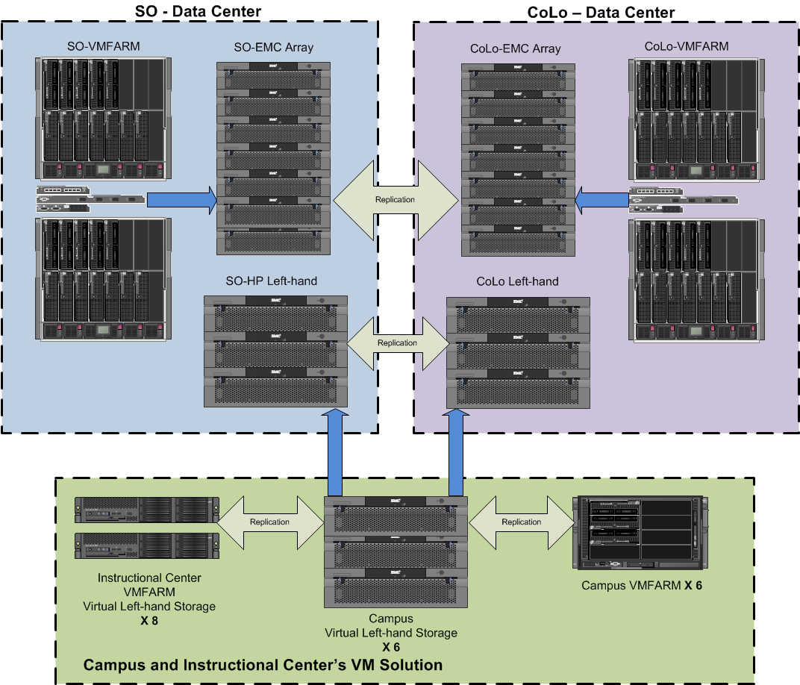
LSCS – Private Cloud
Example
Availability & Flexibility
Important the network must be designed for flexibility
More than vMotion and SRM
Simplified Maintenance
Enables
IT as a Service
VM-SRM moves servers
VM-SRM moves servers
Notes:
Our VM world presentation in 2010

Slide 13
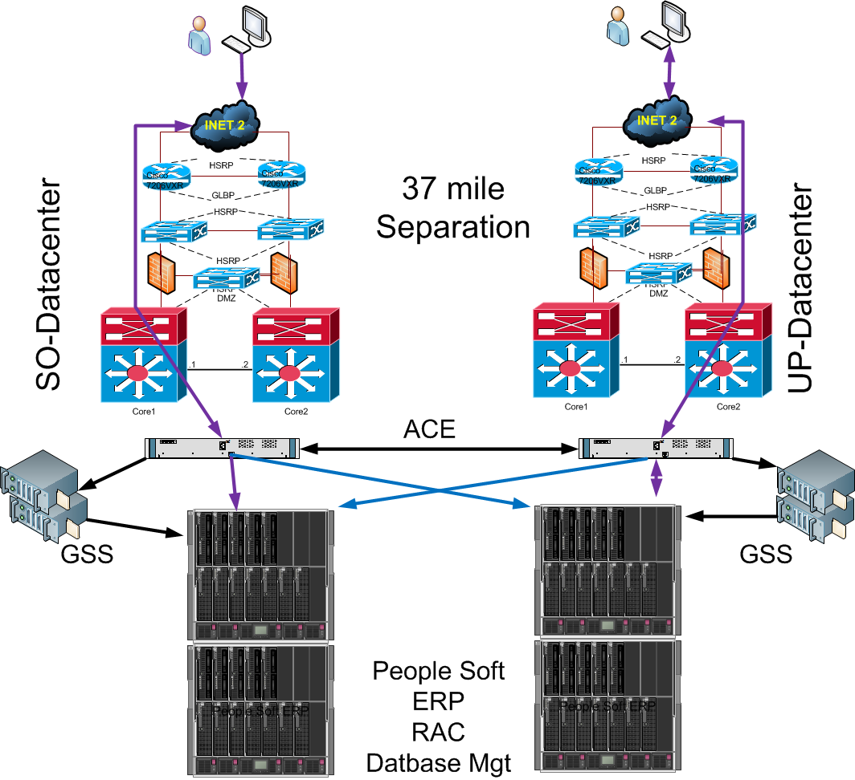
Private Cloud - Differentiator
Adding value to the organization
Problem 1
  Our ERP would crash regularly and services were limited at times
Problem 2
  90,000 students hammering our systems to register for classes in a short time frame 2-3 weeks
Our Solution
  PeopleSoft ERP
  Our Private Cloud

Slide 14
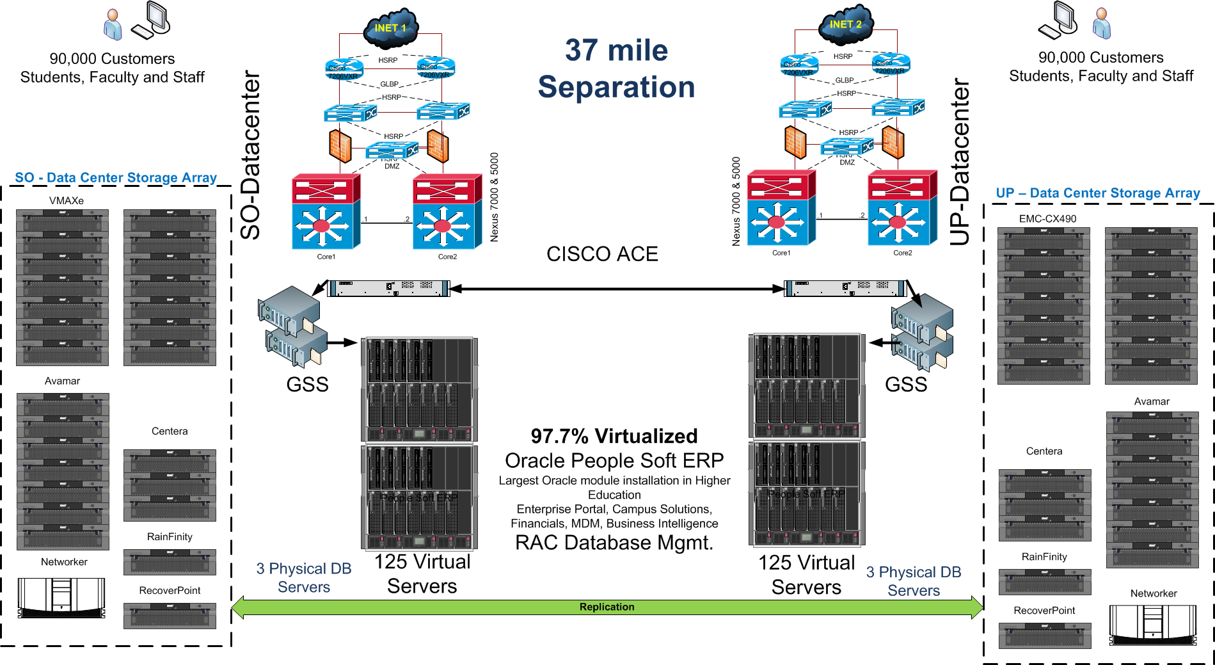
ERP Availability - 5-nines (99.999)

Slide 15
ERP Availability - 5-nines (99.999)

Slide 16
ERP Availability - 5-nines (99.999)

Slide 17
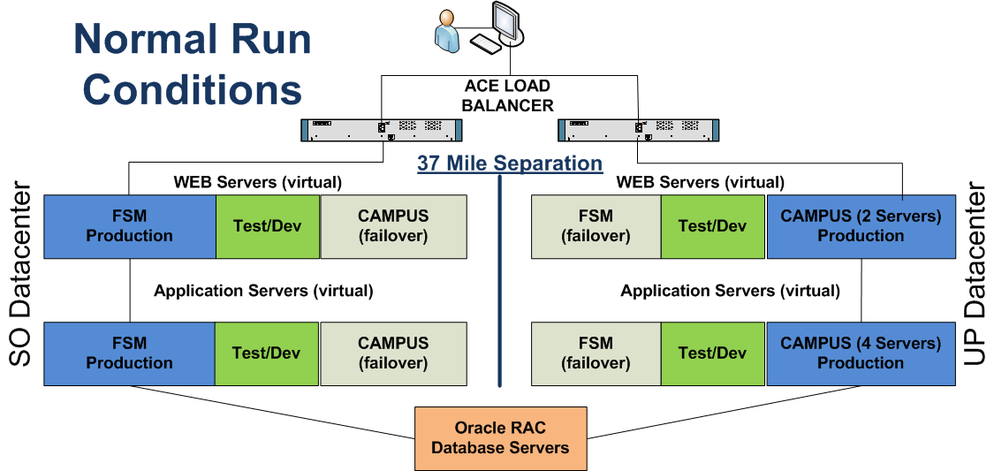
ERP - Elasticity
Example – Elasticity – Normal Operations
Application awareness
Peak demand management
Improved application service delivery

Slide 18
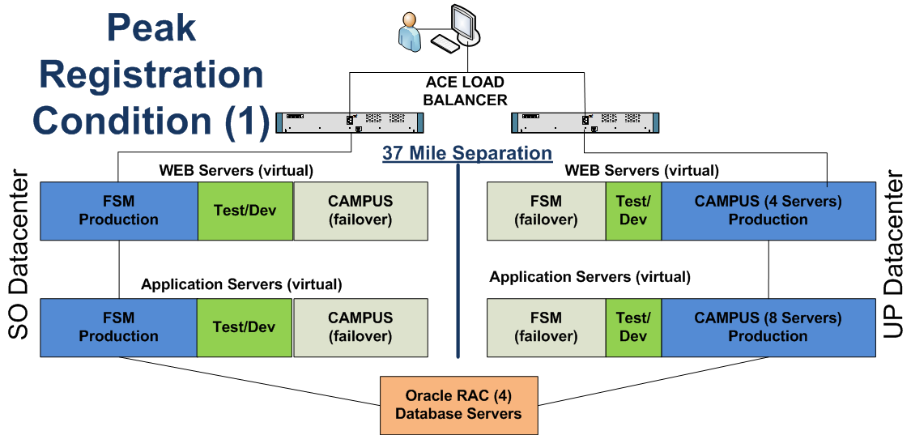
ERP - Elasticity
Example – Elasticity – Peak Registration
Dynamic expansion of capacity on the primary side
Increased production Web and Application Servers – Primary side
Reduced the size of the Test/Dev environment

Slide 19
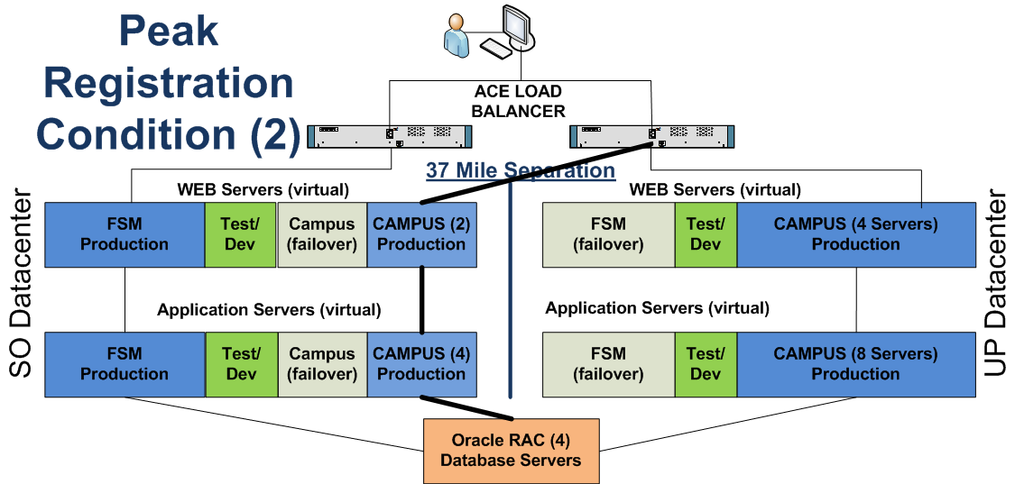
ERP - Elasticity
Example – Elasticity – Peak Registration
Dynamic expansion of capacity using both sides
Increased production Web and Application Servers
Reduced the size of the Test/Dev environment

Slide 20
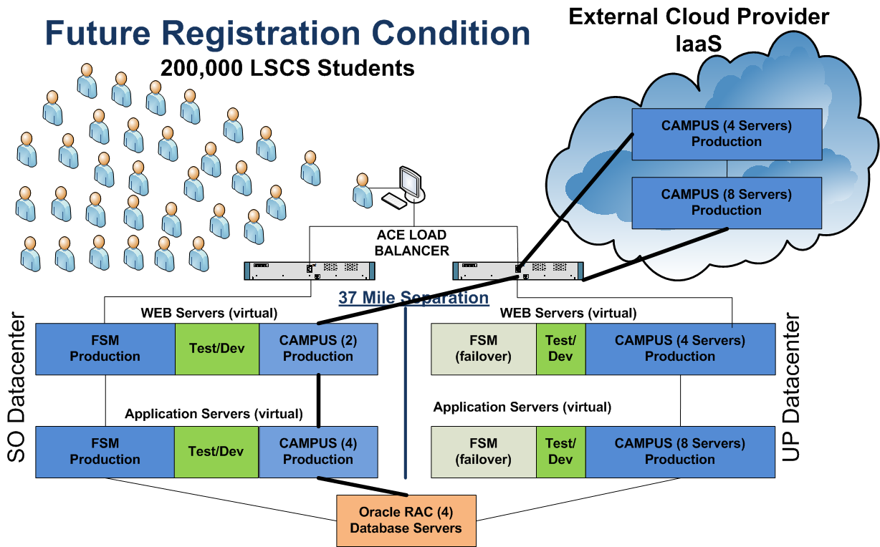
The Next Level - Hybrid

Slide 21
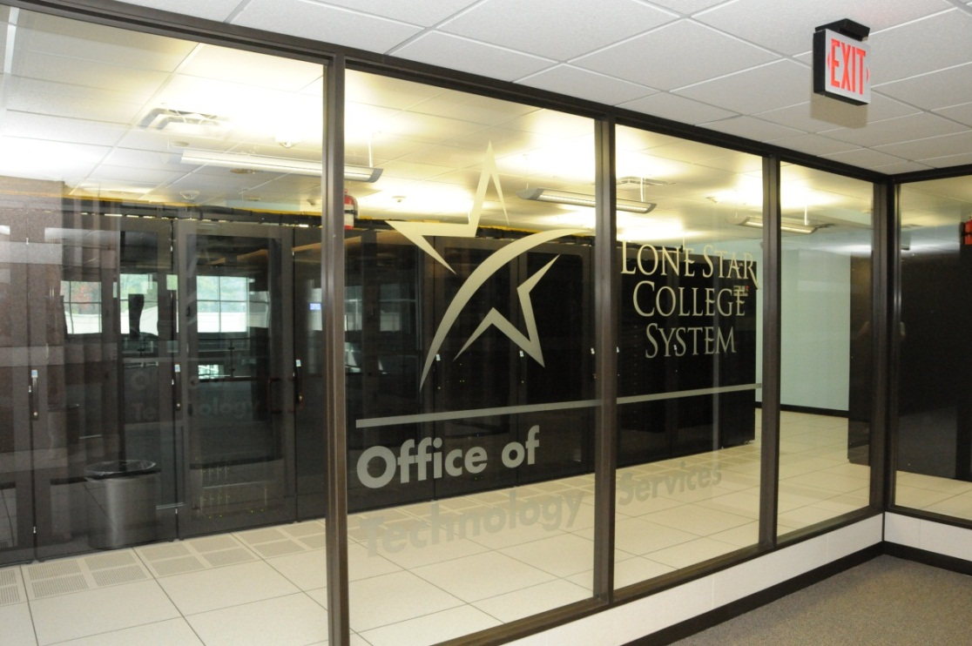
What does it Really Mean?
Dynamic reallocation of computing resources
No downtime or performance loss during peak system demands
I.T. is addressing the business and customers needs
Enterprise Agility!

Slide 22
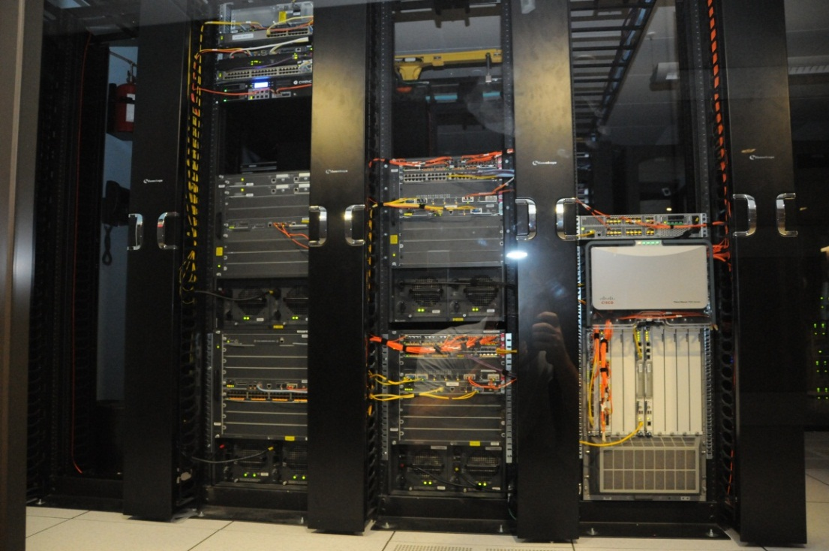
Challenges
Organizational
  Where is my data?
  What controls are in place?
  VM Sprawl
Operational
  Training, training and more training
  Team integration
  Storage
Functional
  Application developers
  Business process owners
Change your Mindset
The organization does not care how you do it. They are only concerned with getting it done!

Slide 23
IT Organizational Impact
Rethink
Your staff now has to rethink how they will address a new business goals
System Management
  You still have applications or servers that will need support
  You will need to monitor security & mitigate risks
Contract Management
  Strong partnership with your cloud provider
  Monitor SLA & KPI & Security
Cost Models
  You Pay for what you need
  CPU, Storage, Bandwidth, Licenses
  Yearly, Quarterly, Monthly
Retool
Your staff must have the technologies that enable the cloud
Retrain
Your staff needs more than just technology training they need to understand the organizations goals and how to add value

Slide 24
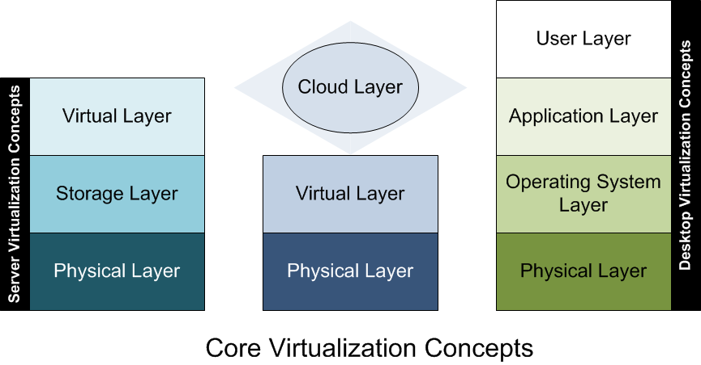
What’s Next for LSCS
Virtualize Everything
  Desktops
  Applications
  Users
Dynamic – On Demand - Desktops-as-a-Service
vCloud Director
Cisco Overlay Transport Virtualization (OTV)

Slide 25
Our Private Cloud Today
VM Capacity
Hardware
19 datacenters
218 resource pools
87 ESX hosts
Overall Resource Pool
2.1 THz processing power
5.2 TB of Memory
172 Physical CPUs
1349 VM CPU cores
HP Blade System
  9 – c7000 Chassis
  6 – c3000 Chassis
  BL460 & BL490
HP Left-hand storage
  250 TB replicated
EMC
  450 TB unified storage
  VMAXe & CX490
  Avamar Disk to Disk Backup
  Recover Point
VMware ELA
Cisco Nexus 7000 (2) 5000 (4)
Cisco ACE Load Balancer

Slide 26
Questions
IT as a Service:
Leveraging Private, Public and Hybrid Clouds at Lone Star!
Presentation Resources
National Institute of Standards Technology
Version 15
Cloud Computing with VMware vCloud Director
USENIX #24
Gartner
Key Issues for Cloud Computing
G00175264
IT Process Institute
IT Value Transformation Road Map
VMware
Evolutionary Approach to an IT Revolution
Link Alander,
Associate Vice Chancellor,
Technology Services
Cory Bradfield
Senior System Administrator

